Slide 1
Derivatives of Exponential Functions

Slide 2
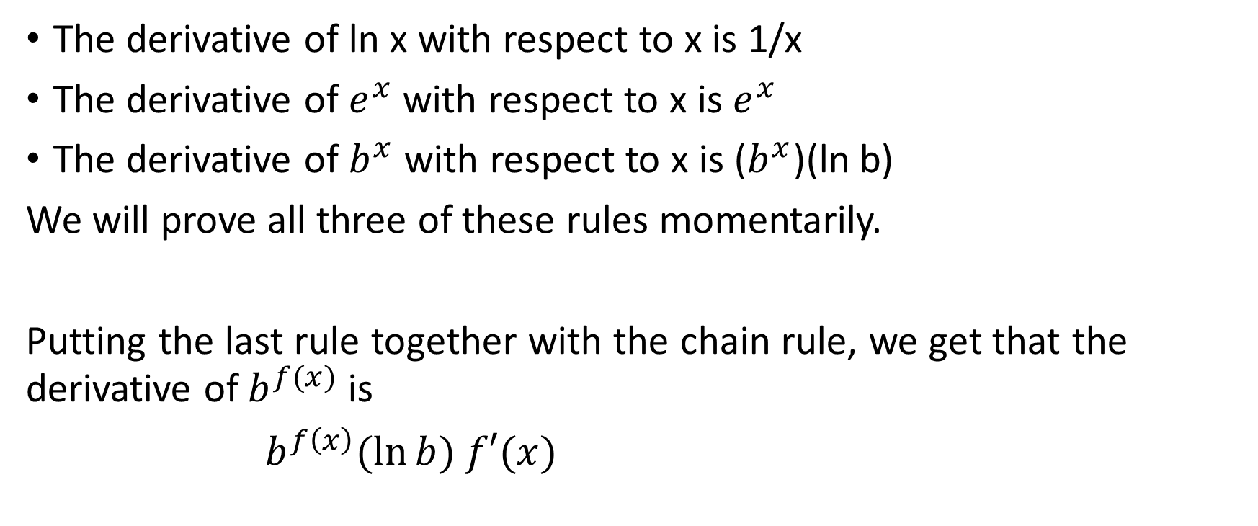
Three key rules for this section
The derivative of ln x with respect to x is 1/x
The derivative of $e^{x}$ with respect to x is $e^{x}$
The derivative of $b^{x}$ with respect to x is ($b^{x}$)(ln b)
We will prove all three of these rules momentarily.
Putting the last rule together with the chain rule, we get that the derivative of $b^{f(x)}$ is
$b^{f\left(x\right)}(\ln{b) f′(x)}$

Slide 3

Proof #1
Required To Prove: $\frac{d(\ln{x)}}{dx}=\frac{1}{x}$
Proof:
$\frac{d(\ln{x)}}{dx}=\lim_{h→0}{\frac{\ln\left(x+h\right)−\ln{x}}{h}}$

Slide 4




Required To Prove: $\frac{d(\ln{x)}}{dx}=\frac{1}{x}$
Proof (continued):
$\frac{d(\ln{x)}}{dx}=\lim_{h→0}{\frac{\ln\left(x+h\right)−\ln{x}}{h}}$
Recall that ln is a logarithm, and that a rule of logarithms states that when you subtract logarithms of the same base, you can just determine the logarithm of the quotient.
In other words, $\ln\left(x+h\right)−\ln{x=\ln\left(\frac{x+h}{x}\right)}$

Slide 5

Required To Prove: $\frac{d(\ln{x)}}{dx}=\frac{1}{x}$
Proof (continued):
$\frac{d(\ln{x)}}{dx}=\lim_{h→0}{\frac{\ln\left(x+h\right)−\ln{x}}{h}}$
$=\lim_{h→0}{\frac{\ln\left(\frac{x+h}{x}\right)}{h}}$

Slide 6

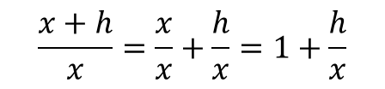
Required To Prove: $\frac{d(\ln{x)}}{dx}=\frac{1}{x}$
Proof (continued):
$\frac{d(\ln{x)}}{dx}=\lim_{h→0}{\frac{\ln\left(x+h\right)−\ln{x}}{h}}$
$=\lim_{h→0}{\frac{\ln\left(\frac{x+h}{x}\right)}{h}}$
$$\frac{x+h}{x}=\frac{x}{x}+\frac{h}{x}=1+\frac{h}{x}$$

Slide 7

Required To Prove: $\frac{d(\ln{x)}}{dx}=\frac{1}{x}$
Proof (continued):
$\frac{d(\ln{x)}}{dx}=\lim_{h→0}{\frac{\ln\left(x+h\right)−\ln{x}}{h}}$
$=\lim_{h→0}{\frac{\ln\left(\frac{x+h}{x}\right)}{h}}$
$=\lim_{h→0}{\frac{\ln\left(1+\frac{h}{x}\right)}{h}}$
$=\lim_{h→0}\left(\frac{1}{h}\right)\ln\left(1+\frac{h}{x}\right)$

Slide 8

Required To Prove: $\frac{d(\ln{x)}}{dx}=\frac{1}{x}$
Proof (continued):
$=\lim_{h→0}\left(\frac{1}{h}\right)\ln\left(1+\frac{h}{x}\right)$

Slide 9
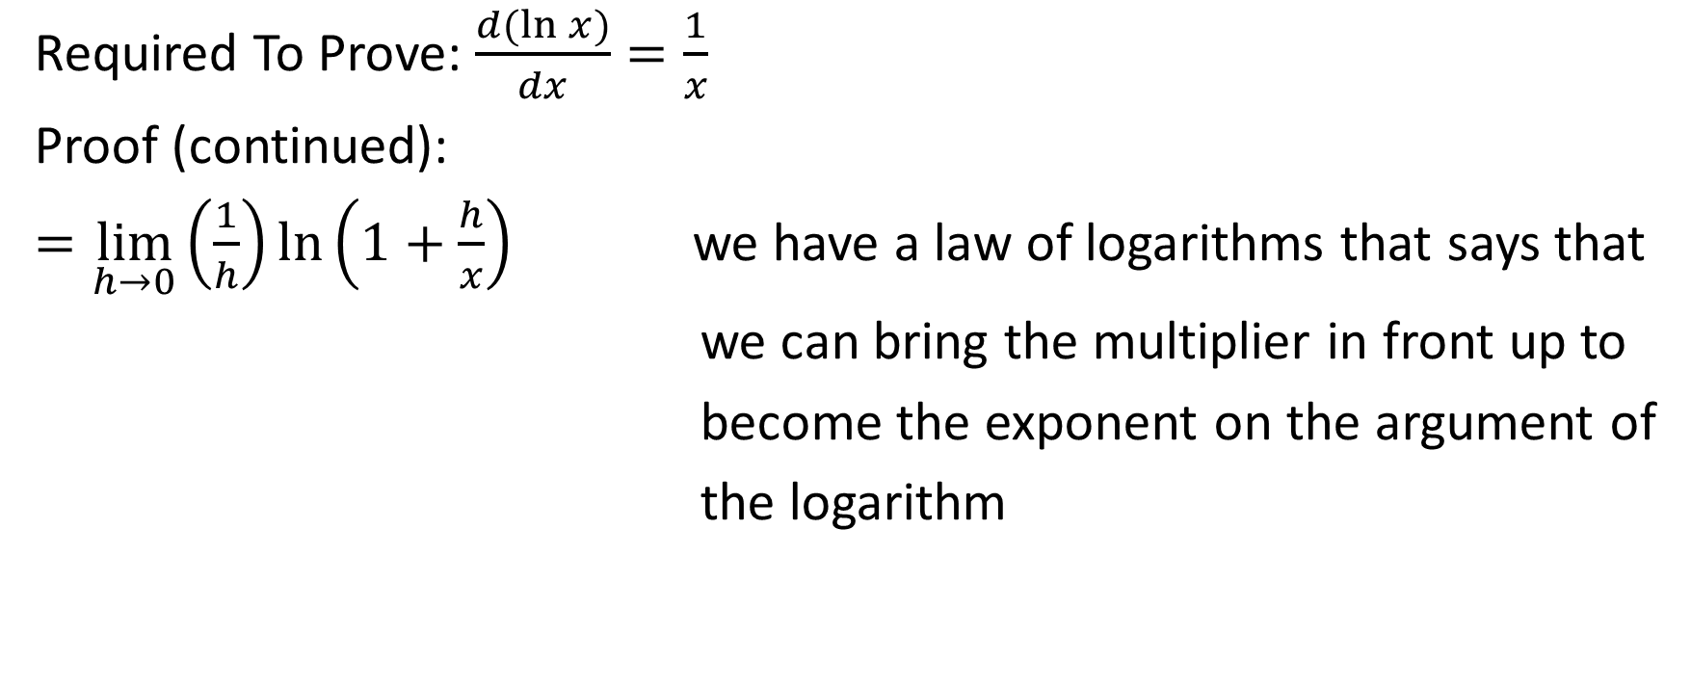

Required To Prove: $\frac{d(\ln{x)}}{dx}=\frac{1}{x}$
Proof (continued):
$=\lim_{h→0}\left(\frac{1}{h}\right)\ln\left(1+\frac{h}{x}\right)$ we have a law of logarithms that says that
we can bring the multiplier in front up to
become the exponent on the argument of
the logarithm

Slide 10

Required To Prove: $\frac{d(\ln{x)}}{dx}=\frac{1}{x}$
Proof (continued):
$=\lim_{h→0}\left(\frac{1}{h}\right)\ln\left(1+\frac{h}{x}\right)$
$=\lim_{h→0}{\ln{{\left(1+\frac{h}{x}\right)}^{\frac{1}{h}}}}$

Slide 11
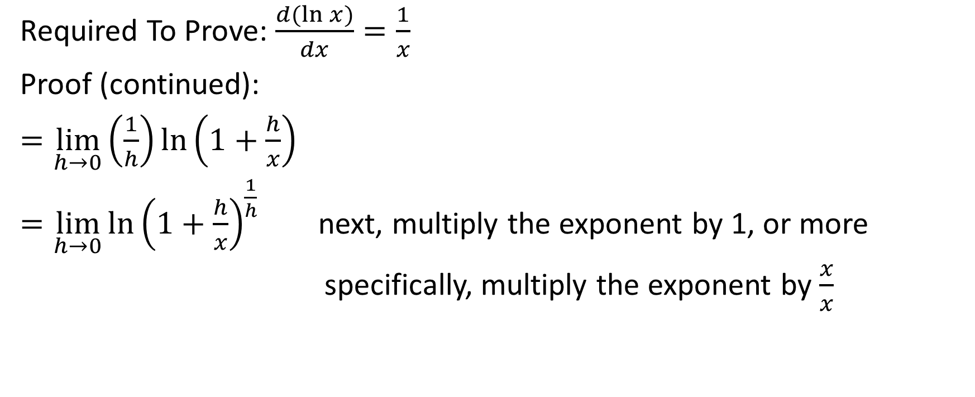
Required To Prove: $\frac{d(\ln{x)}}{dx}=\frac{1}{x}$
Proof (continued):
$=\lim_{h→0}\left(\frac{1}{h}\right)\ln\left(1+\frac{h}{x}\right)$
$=\lim_{h→0}{\ln{{\left(1+\frac{h}{x}\right)}^{\frac{1}{h}}}}$ next, multiply the exponent by 1, or more
specifically, multiply the exponent by $\frac{x}{x}$

Slide 12

Required To Prove: $\frac{d(\ln{x)}}{dx}=\frac{1}{x}$
Proof (continued):
$=\lim_{h→0}\left(\frac{1}{h}\right)\ln\left(1+\frac{h}{x}\right)$
$=\lim_{h→0}{\ln{{\left(1+\frac{h}{x}\right)}^{\frac{1}{h}}}}$
$=\lim_{h→0}{\ln{{\left(1+\frac{h}{x}\right)}^{\left(\frac{1}{h}\right)\left(\frac{x}{x}\right)}}}$

Slide 13

Required To Prove: $\frac{d(\ln{x)}}{dx}=\frac{1}{x}$
Proof (continued):
$=\lim_{h→0}{\ln{{\left(1+\frac{h}{x}\right)}^{\left(\frac{1}{h}\right)\left(\frac{x}{x}\right)}}}$

Slide 14


Required To Prove: $\frac{d(\ln{x)}}{dx}=\frac{1}{x}$
Proof (continued):
$=\lim_{h→0}{\ln{{\left(1+\frac{h}{x}\right)}^{\left(\frac{1}{h}\right)\left(\frac{x}{x}\right)}}}$
Re-express $\left(\frac{1}{h}\right)\left(\frac{x}{x}\right)$ as $\left(\frac{x}{h}\right)\left(\frac{1}{x}\right)$

Slide 15

Required To Prove: $\frac{d(\ln{x)}}{dx}=\frac{1}{x}$
Proof (continued):
$=\lim_{h→0}{\ln{{\left(1+\frac{h}{x}\right)}^{\left(\frac{1}{h}\right)\left(\frac{x}{x}\right)}}}$
$=\lim_{h→0}{\ln{{\left(1+\frac{h}{x}\right)}^{\left(\frac{x}{h}\right)\left(\frac{1}{x}\right)}}}$

Slide 16


Required To Prove: $\frac{d(\ln{x)}}{dx}=\frac{1}{x}$
Proof (continued):
$=\lim_{h→0}{\ln{{\left(1+\frac{h}{x}\right)}^{\left(\frac{1}{h}\right)\left(\frac{x}{x}\right)}}}$
$=\lim_{h→0}{\ln{{\left(1+\frac{h}{x}\right)}^{\left(\frac{x}{h}\right)\left(\frac{1}{x}\right)}}}$

Slide 17

Required To Prove: $\frac{d(\ln{x)}}{dx}=\frac{1}{x}$
Proof (continued):
$=\lim_{h→0}{\ln{{\left(1+\frac{h}{x}\right)}^{\left(\frac{1}{h}\right)\left(\frac{x}{x}\right)}}}$
$=\lim_{h→0}{\ln{{\left(1+\frac{h}{x}\right)}^{\left(\frac{x}{h}\right)\left(\frac{1}{x}\right)}}}$
$=\lim_{h→0}\left(\frac{1}{x}\right)\ln{{\left(1+\frac{h}{x}\right)}^{\frac{x}{h}}}$

Slide 18

Required To Prove: $\frac{d(\ln{x)}}{dx}=\frac{1}{x}$
Proof (continued):
$=\lim_{h→0}\left(\frac{1}{x}\right)\ln{{\left(1+\frac{h}{x}\right)}^{\frac{x}{h}}}$

Slide 19
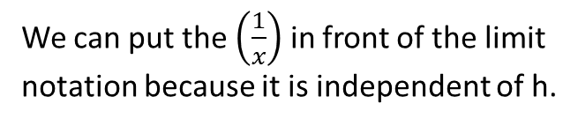

Required To Prove: $\frac{d(\ln{x)}}{dx}=\frac{1}{x}$
Proof (continued):
$=\lim_{h→0}\left(\frac{1}{x}\right)\ln{{\left(1+\frac{h}{x}\right)}^{\frac{x}{h}}}$
We can put the $\left(\frac{1}{x}\right)$ in front of the limit notation because it is independent of h.

Slide 20

Required To Prove: $\frac{d(\ln{x)}}{dx}=\frac{1}{x}$
Proof (continued):
$=\lim_{h→0}\left(\frac{1}{x}\right)\ln{{\left(1+\frac{h}{x}\right)}^{\frac{x}{h}}}$
$=\left(\frac{1}{x}\right)\lim_{h→0}{\ln{{\left(1+\frac{h}{x}\right)}^{\frac{x}{h}}}}$

Slide 21
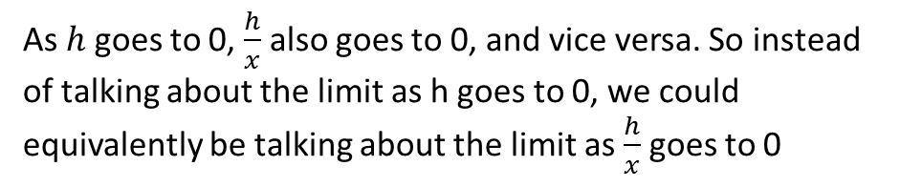



Required To Prove: $\frac{d(\ln{x)}}{dx}=\frac{1}{x}$
Proof (continued):
$=\lim_{h→0}\left(\frac{1}{x}\right)\ln{{\left(1+\frac{h}{x}\right)}^{\frac{x}{h}}}$
$=\left(\frac{1}{x}\right)\lim_{h→0}{\ln{{\left(1+\frac{h}{x}\right)}^{\frac{x}{h}}}}$
As $h$ goes to 0, $\frac{h}{x}$ also goes to 0, and vice versa. So instead of talking about the limit as h goes to 0, we could equivalently be talking about the limit as $\frac{h}{x}$ goes to 0

Slide 22

Required To Prove: $\frac{d(\ln{x)}}{dx}=\frac{1}{x}$
Proof (continued):
$=\lim_{h→0}\left(\frac{1}{x}\right)\ln{{\left(1+\frac{h}{x}\right)}^{\frac{x}{h}}}$
$=\left(\frac{1}{x}\right)\lim_{h→0}{\ln{{\left(1+\frac{h}{x}\right)}^{\frac{x}{h}}}}$
$=\left(\frac{1}{x}\right)\lim_{\frac{h}{x} →0}{\ln{{\left(1+\frac{h}{x}\right)}^{\frac{x}{h}}}}$

Slide 23

Required To Prove: $\frac{d(\ln{x)}}{dx}=\frac{1}{x}$
Proof (continued):
$=\left(\frac{1}{x}\right)\lim_{\frac{h}{x} →0}{\ln{{\left(1+\frac{h}{x}\right)}^{\frac{x}{h}}}}$

Slide 24

Required To Prove: $\frac{d(\ln{x)}}{dx}=\frac{1}{x}$
Proof (continued):
$=\left(\frac{1}{x}\right)\lim_{\frac{h}{x} →0}{\ln{{\left(1+\frac{h}{x}\right)}^{\frac{x}{h}}}}$ If we let $w=\frac{h}{x}$ , then $\frac{1}{w}=\frac{x}{h}$

Slide 25

Required To Prove: $\frac{d(\ln{x)}}{dx}=\frac{1}{x}$
Proof (continued):
$=\left(\frac{1}{x}\right)\lim_{\frac{h}{x} →0}{\ln{{\left(1+\frac{h}{x}\right)}^{\frac{x}{h}}}}$
$=\left(\frac{1}{x}\right)\lim_{w→0}{\ln{{(1+w)}^{\frac{1}{w}}}}$

Slide 26
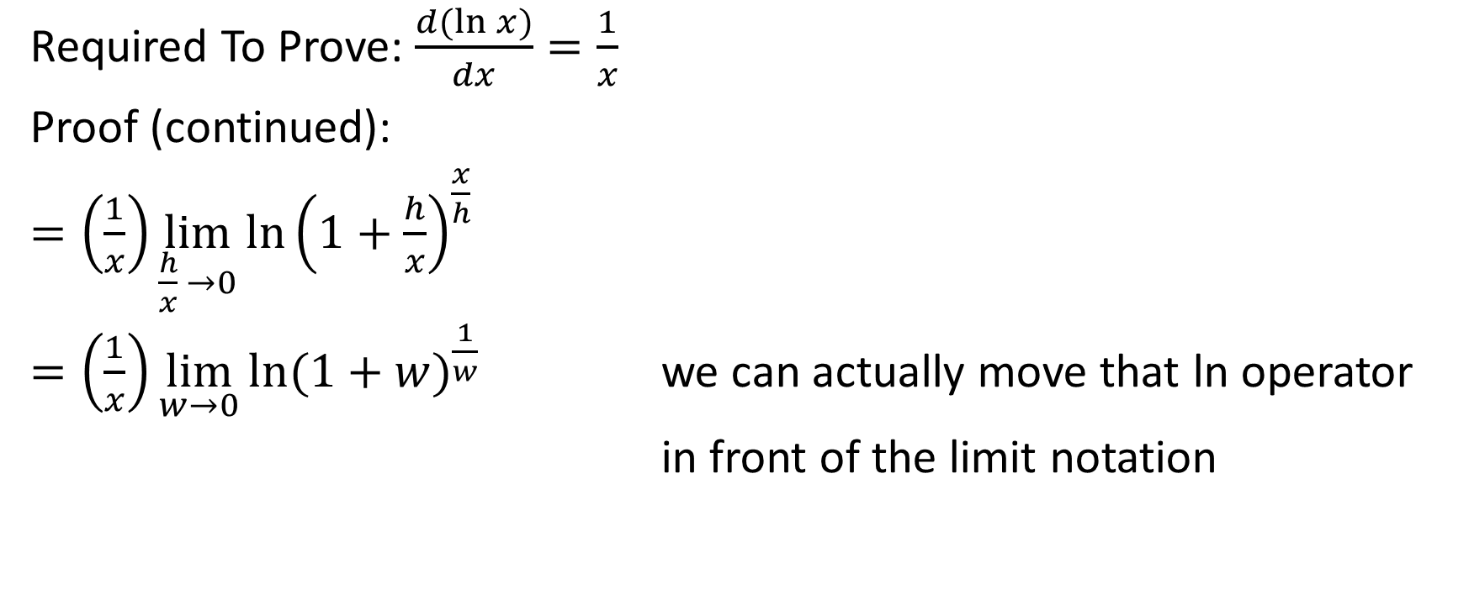

Required To Prove: $\frac{d(\ln{x)}}{dx}=\frac{1}{x}$
Proof (continued):
$=\left(\frac{1}{x}\right)\lim_{\frac{h}{x} →0}{\ln{{\left(1+\frac{h}{x}\right)}^{\frac{x}{h}}}}$
$=\left(\frac{1}{x}\right)\lim_{w→0}{\ln{{(1+w)}^{\frac{1}{w}}}}$ we can actually move that ln operator
in front of the limit notation

Slide 27

Required To Prove: $\frac{d(\ln{x)}}{dx}=\frac{1}{x}$
Proof (continued):
$=\left(\frac{1}{x}\right)\lim_{\frac{h}{x} →0}{\ln{{\left(1+\frac{h}{x}\right)}^{\frac{x}{h}}}}$
$=\left(\frac{1}{x}\right)\lim_{w→0}{\ln{{(1+w)}^{\frac{1}{w}}}}$
$=\left(\frac{1}{x}\right)\ln\left[\lim_{w→0}{{\left(1+w\right)}^{\frac{1}{w}}}\right]$

Slide 28
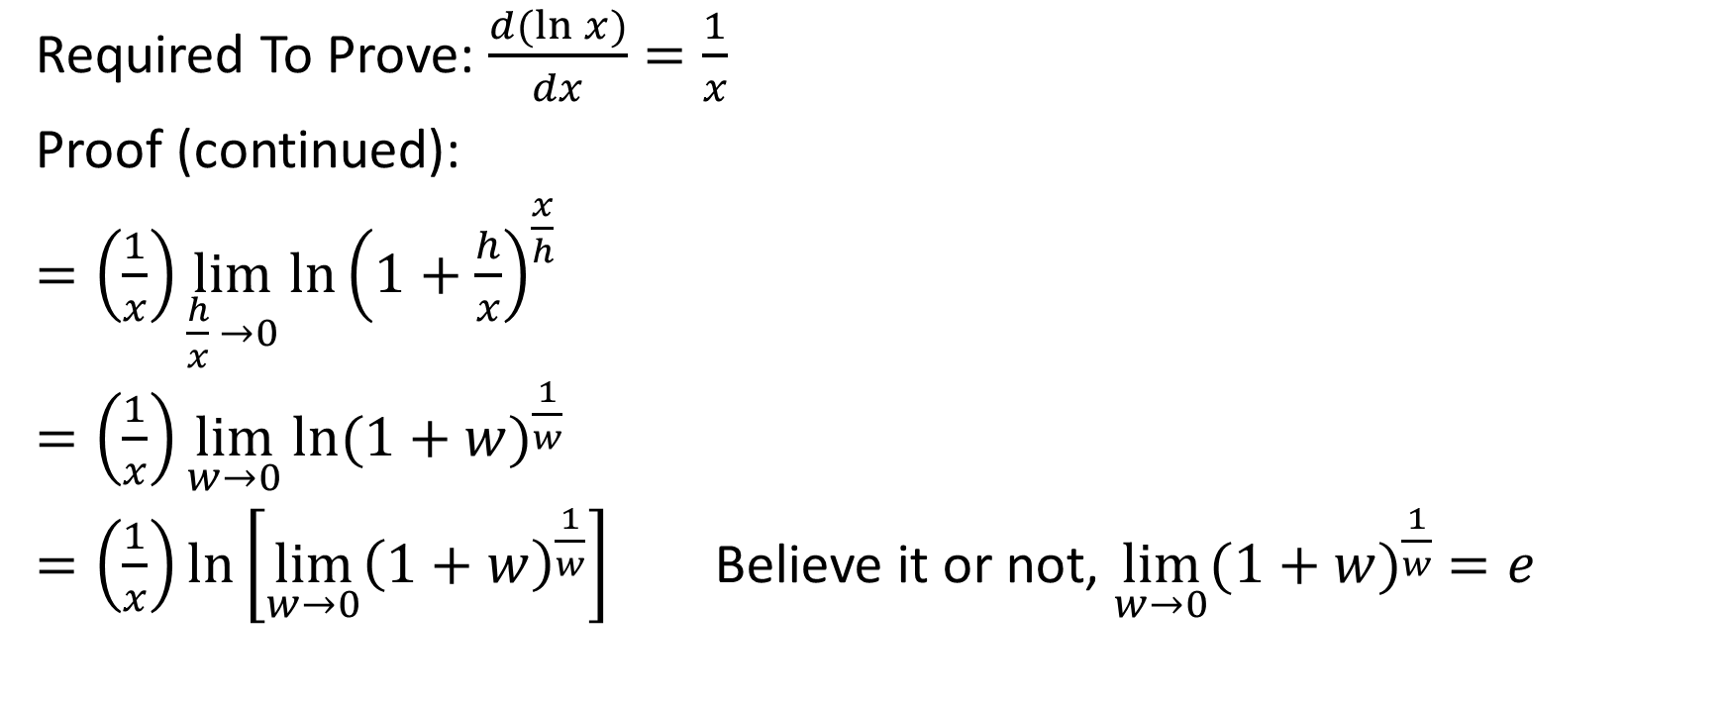

Required To Prove: $\frac{d(\ln{x)}}{dx}=\frac{1}{x}$
Proof (continued):
$=\left(\frac{1}{x}\right)\lim_{\frac{h}{x} →0}{\ln{{\left(1+\frac{h}{x}\right)}^{\frac{x}{h}}}}$
$=\left(\frac{1}{x}\right)\lim_{w→0}{\ln{{(1+w)}^{\frac{1}{w}}}}$
$=\left(\frac{1}{x}\right)\ln\left[\lim_{w→0}{{\left(1+w\right)}^{\frac{1}{w}}}\right]$ Believe it or not, $\lim_{w→0}{{(1+w)}^{\frac{1}{w}} =e}$

Slide 29





Required To Prove: $\frac{d(\ln{x)}}{dx}=\frac{1}{x}$
Proof (continued):
$=\left(\frac{1}{x}\right)\lim_{\frac{h}{x} →0}{\ln{{\left(1+\frac{h}{x}\right)}^{\frac{x}{h}}}}$
$=\left(\frac{1}{x}\right)\lim_{w→0}{\ln{{(1+w)}^{\frac{1}{w}}}}$
$=\left(\frac{1}{x}\right)\ln\left[\lim_{w→0}{{\left(1+w\right)}^{\frac{1}{w}}}\right]$ Believe it or not, $\lim_{w→0}{{(1+w)}^{\frac{1}{w}} =e}$
As an illustration that $\lim_{w →0}{{\left(1+w\right)}^{\frac{1}{w}}=e}$, but not a rigorous proof, consider the following
${(1+0.1)}^{\frac{1}{0.1}}≅2.5937$
${(1+0.01)}^{\frac{1}{0.01}}≅2.7048$
${\left(1+0.001\right)}^{\frac{1}{0.001}}≅2.7169$
${(1+0.0001)}^{\frac{1}{0.0001}}≅2.7181$

Slide 30


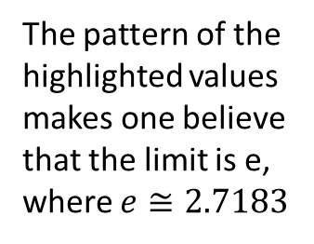



Required To Prove: $\frac{d(\ln{x)}}{dx}=\frac{1}{x}$
Proof (continued):
$=\left(\frac{1}{x}\right)\lim_{\frac{h}{x} →0}{\ln{{\left(1+\frac{h}{x}\right)}^{\frac{x}{h}}}}$
$=\left(\frac{1}{x}\right)\lim_{w→0}{\ln{{(1+w)}^{\frac{1}{w}}}}$
$=\left(\frac{1}{x}\right)\ln\left[\lim_{w→0}{{\left(1+w\right)}^{\frac{1}{w}}}\right]$ Believe it or not, $\lim_{w→0}{{(1+w)}^{\frac{1}{w}} =e}$
As an illustration that $\lim_{w →0}{{\left(1+w\right)}^{\frac{1}{w}}=e}$, but not a rigorous proof, consider the following
${(1+0.1)}^{\frac{1}{0.1}}≅2.5937$
${(1+0.01)}^{\frac{1}{0.01}}≅2.7048$
${\left(1+0.001\right)}^{\frac{1}{0.001}}≅2.7169$
${(1+0.0001)}^{\frac{1}{0.0001}}≅2.7181$
The pattern of the highlighted values makes one believe that the limit is e, where $e≅2.7183$

Slide 31
Required To Prove: $\frac{d(\ln{x)}}{dx}=\frac{1}{x}$
Proof (continued):
$=\left(\frac{1}{x}\right)\lim_{\frac{h}{x} →0}{\ln{{\left(1+\frac{h}{x}\right)}^{\frac{x}{h}}}}$
$=\left(\frac{1}{x}\right)\lim_{w→0}{\ln{{(1+w)}^{\frac{1}{w}}}}$
$=\left(\frac{1}{x}\right)\ln\left[\lim_{w→0}{{\left(1+w\right)}^{\frac{1}{w}}}\right]$ Believe it or not, $\lim_{w→0}{{(1+w)}^{\frac{1}{w}} =e}$

Slide 32

Required To Prove: $\frac{d(\ln{x)}}{dx}=\frac{1}{x}$
Proof (continued):
$=\left(\frac{1}{x}\right)\ln\left[\lim_{w→0}{{\left(1+w\right)}^{\frac{1}{w}}}\right]$ Believe it or not, $\lim_{w→0}{{(1+w)}^{\frac{1}{w}} =e}$

Slide 33

Required To Prove: $\frac{d(\ln{x)}}{dx}=\frac{1}{x}$
Proof (continued):
$=\left(\frac{1}{x}\right)\ln\left[\lim_{w→0}{{\left(1+w\right)}^{\frac{1}{w}}}\right]$ Believe it or not, $\lim_{w→0}{{(1+w)}^{\frac{1}{w}} =e}$
$=\left(\frac{1}{x}\right)\ln{e}$

Slide 34
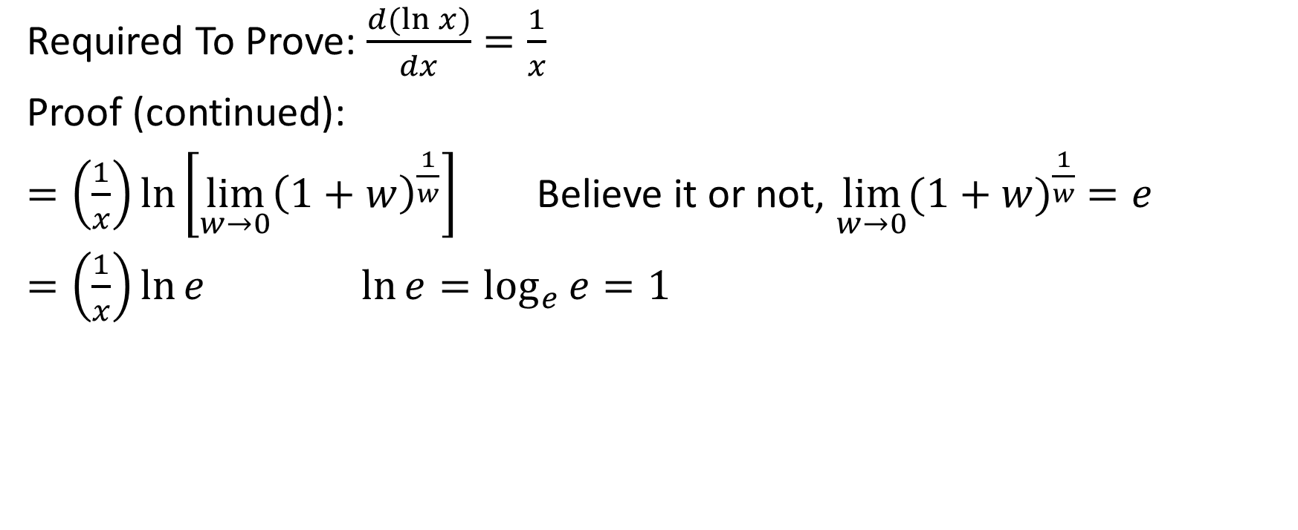
Required To Prove: $\frac{d(\ln{x)}}{dx}=\frac{1}{x}$
Proof (continued):
$=\left(\frac{1}{x}\right)\ln\left[\lim_{w→0}{{\left(1+w\right)}^{\frac{1}{w}}}\right]$ Believe it or not, $\lim_{w→0}{{(1+w)}^{\frac{1}{w}} =e}$
$=\left(\frac{1}{x}\right)\ln{e}$ $\ln{e=\log_{e}{e}=1}$

Slide 35
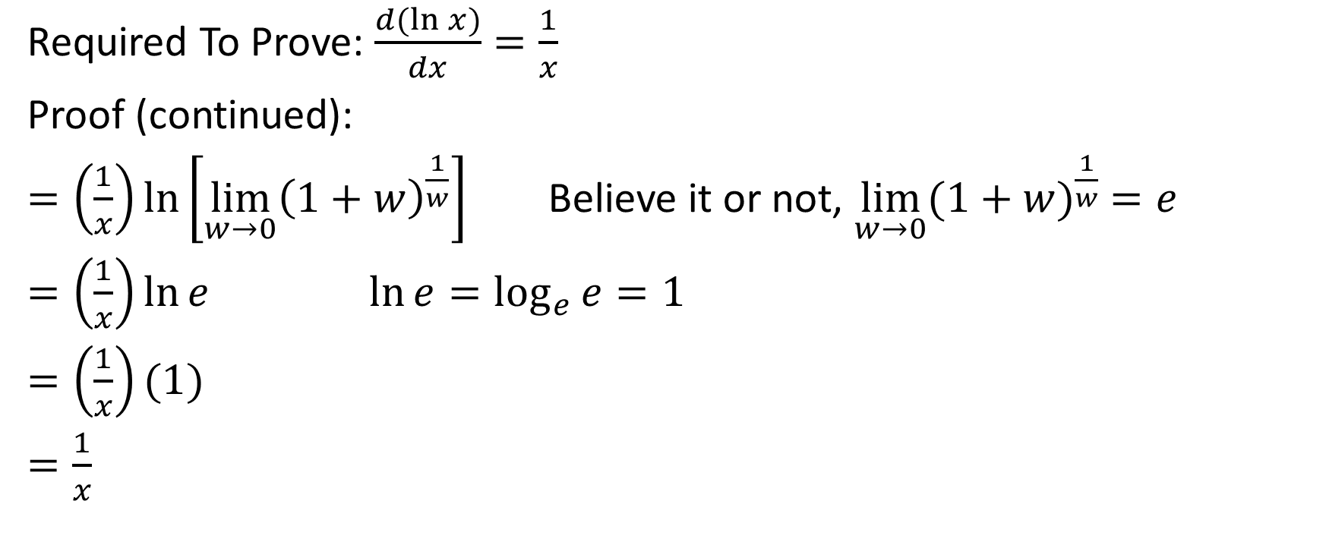
Required To Prove: $\frac{d(\ln{x)}}{dx}=\frac{1}{x}$
Proof (continued):
$=\left(\frac{1}{x}\right)\ln\left[\lim_{w→0}{{\left(1+w\right)}^{\frac{1}{w}}}\right]$ Believe it or not, $\lim_{w→0}{{(1+w)}^{\frac{1}{w}} =e}$
$=\left(\frac{1}{x}\right)\ln{e}$ $\ln{e=\log_{e}{e}=1}$
$=\left(\frac{1}{x}\right)(1)$
$=\frac{1}{x}$

Slide 36


Required To Prove: $\frac{d(\ln{x)}}{dx}=\frac{1}{x}$
Proof (continued):
Therefore, $\frac{d(\ln{x)}}{dx}=\frac{1}{x}$

Slide 37

Proof #2
Required to Prove
$\frac{d\left(e^{x}\right)}{dx}=e^{x}$

Slide 38

Required to Prove
$\frac{d\left(e^{x}\right)}{dx}=e^{x}$
Proof:
Let $y=e^{x}$
Therefore, $\ln{y=\ln{e^{x}}}$

Slide 39




Required to Prove
$\frac{d\left(e^{x}\right)}{dx}=e^{x}$
Proof (continued):
Let $y=e^{x}$
Therefore, $\ln{y=\ln{e^{x}}}$
$\ln{e^{x}=x}$. You might recognize this by observation. But if you don’t see that, consider the following:
Let $w=\ln{e^{x}}$
Therefore, $w=\log_{e}{{(e}^{x})}$
$e^{w}=e^{x}$
$w=x$
Therefore, $\ln{e^{x}}=x$

Slide 40

Required to Prove
$\frac{d\left(e^{x}\right)}{dx}=e^{x}$
Proof (continued):
Let $y=e^{x}$
Therefore, $\ln{y=\ln{e^{x}}}$
$\ln{y=x}$
Now, do some implicit differentiation

Slide 41
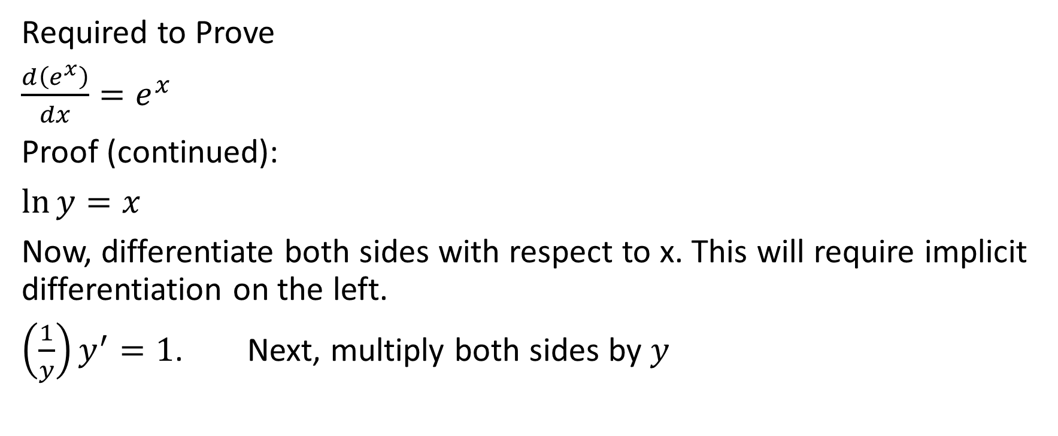
Required to Prove
$\frac{d\left(e^{x}\right)}{dx}=e^{x}$
Proof (continued):
$\ln{y=x}$
Now, differentiate both sides with respect to x. This will require implicit differentiation on the left.
$\left(\frac{1}{y}\right)y^{′}=1$. Next, multiply both sides by $y$

Slide 42

Required to Prove
$\frac{d\left(e^{x}\right)}{dx}=e^{x}$
Proof (continued):
$\left(\frac{1}{y}\right)y^{′}=1$. Next, multiply both sides by $y$

Slide 43
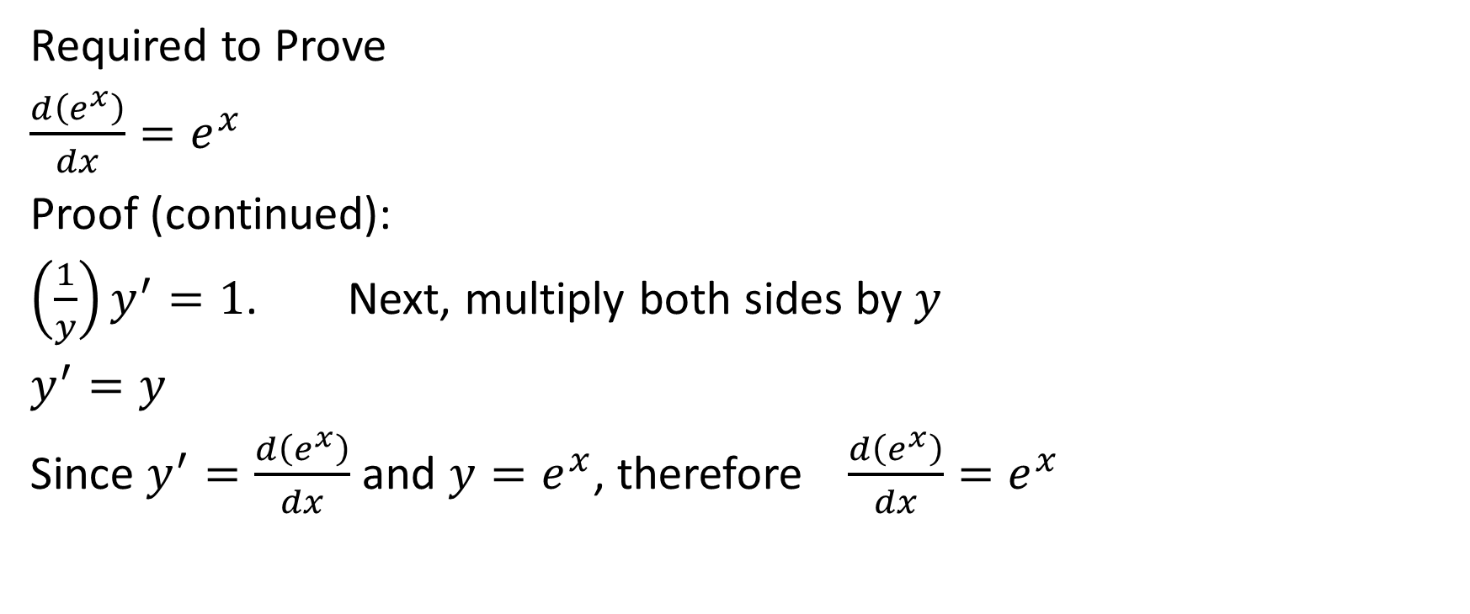

Required to Prove
$\frac{d\left(e^{x}\right)}{dx}=e^{x}$
Proof (continued):
$\left(\frac{1}{y}\right)y^{′}=1$. Next, multiply both sides by $y$
$y^{′}=y$
Since $y^{′}=\frac{d\left(e^{x}\right)}{dx}$ and $y=e^{x}$, therefore $\frac{d\left(e^{x}\right)}{dx}=e^{x}$

Slide 44

Proof #3
Required to Prove: $\frac{d\left(b^{x}\right)}{dx}=b^{x}\left(\ln{b}\right)$

Slide 45
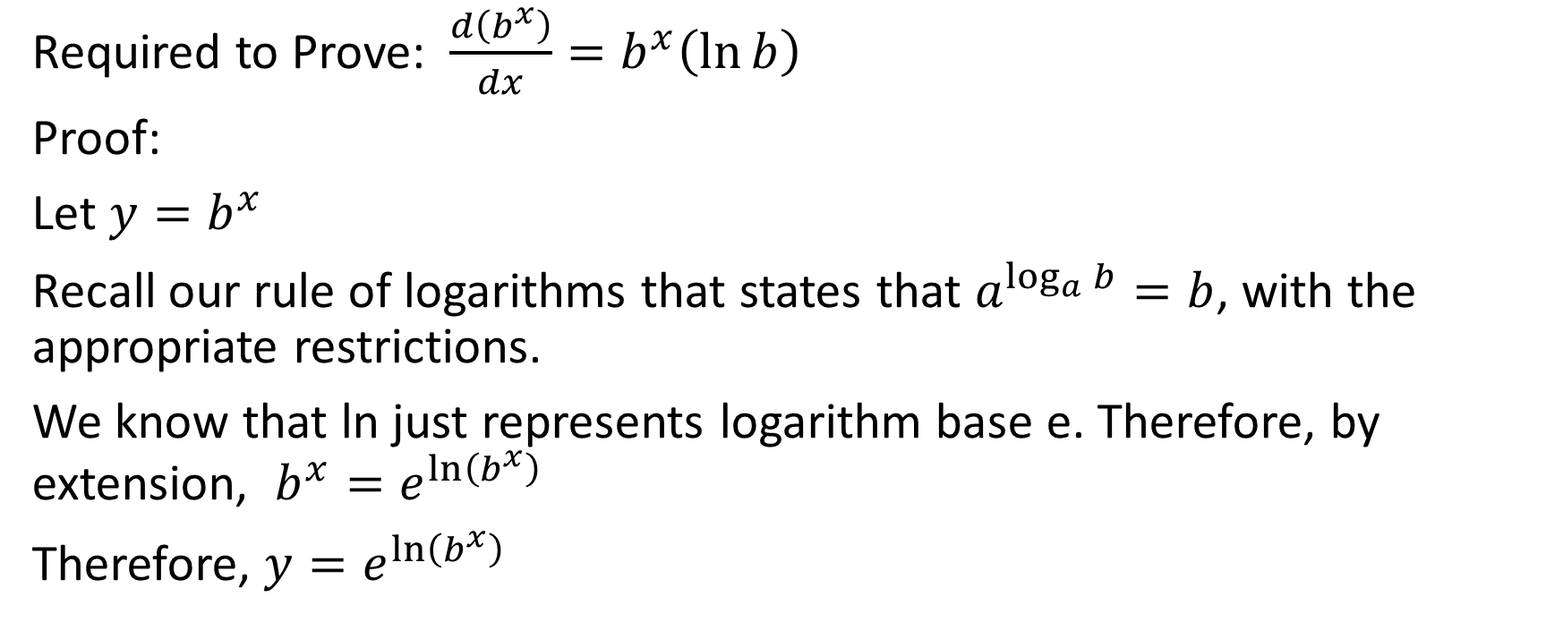
Required to Prove: $\frac{d\left(b^{x}\right)}{dx}=b^{x}\left(\ln{b}\right)$
Proof:
Let $y=b^{x}$
Recall our rule of logarithms that states that $a^{\log_{a}{b}}=b$, with the appropriate restrictions.
We know that ln just represents logarithm base e. Therefore, by extension, $b^{x}=e^{\ln\left(b^{x}\right)}$
Therefore, $y=e^{\ln\left(b^{x}\right)}$

Slide 46

Required to Prove: $\frac{d\left(b^{x}\right)}{dx}=b^{x}\left(\ln{b}\right)$
Proof (continued):
$y=e^{\ln\left(b^{x}\right)}$

Slide 47


Required to Prove: $\frac{d\left(b^{x}\right)}{dx}=b^{x}\left(\ln{b}\right)$
Proof (continued):
$y=e^{\ln\left(b^{x}\right)}$

Slide 48
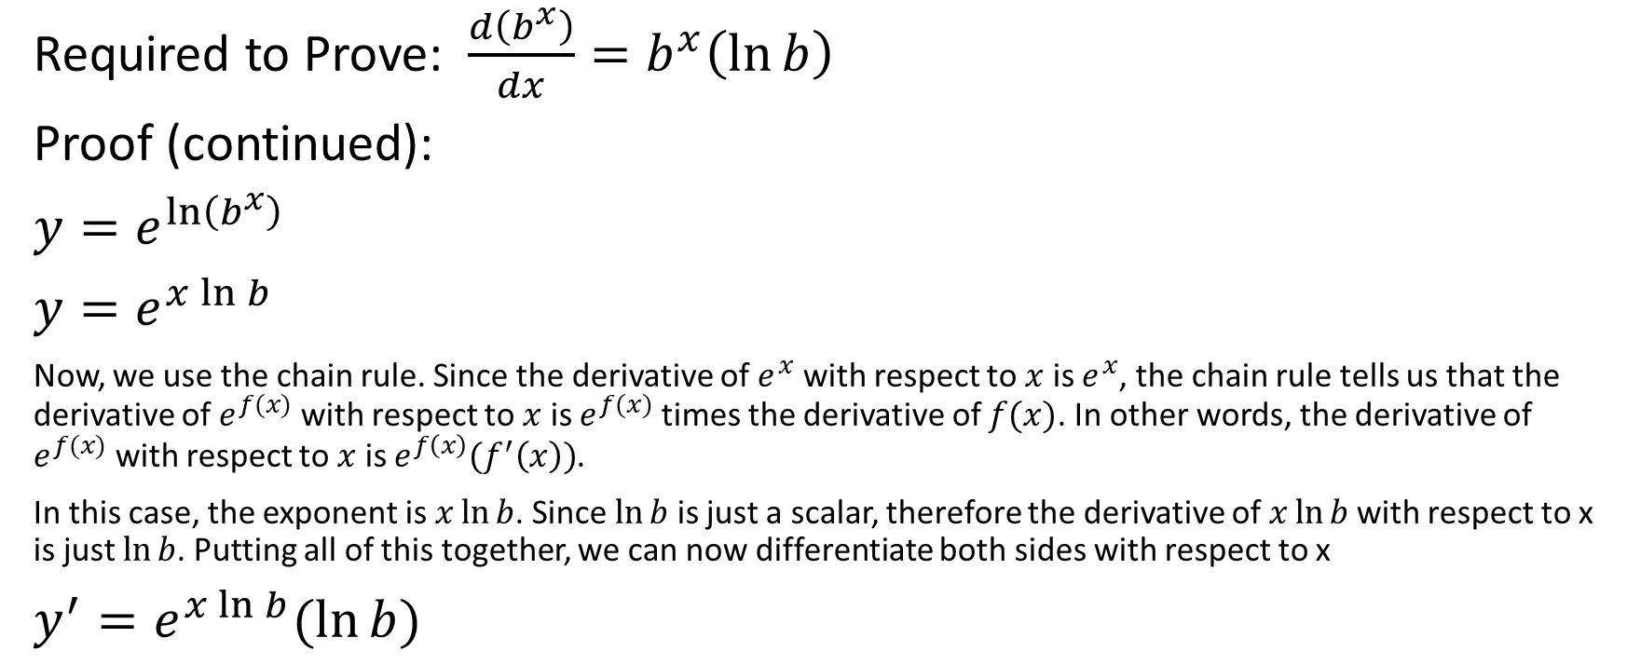
Required to Prove: $\frac{d\left(b^{x}\right)}{dx}=b^{x}\left(\ln{b}\right)$
Proof (continued):
$y=e^{\ln\left(b^{x}\right)}$
$y=e^{x\ln{b}}$
Now, we use the chain rule. Since the derivative of $e^{x}$ with respect to $x$ is $e^{x}$, the chain rule tells us that the derivative of $e^{f(x)}$ with respect to $x$ is $e^{f(x)}$ times the derivative of $f(x)$. In other words, the derivative of $e^{f(x)}$ with respect to $x$ is $e^{f\left(x\right)}(f^{′}\left(x\right))$.
In this case, the exponent is $x\ln{b}$. Since $\ln{b}$ is just a scalar, therefore the derivative of $x\ln{b }$with respect to x is just $\ln{b}$. Putting all of this together, we can now differentiate both sides with respect to x
$y^{′}=e^{x\ln{b}}(\ln{b)}$

Slide 49

Required to Prove: $\frac{d\left(b^{x}\right)}{dx}=b^{x}\left(\ln{b}\right)$
Proof (continued):
$y^{′}=e^{x\ln{b}}(\ln{b)}$

Slide 50
Required to Prove: $\frac{d\left(b^{x}\right)}{dx}=b^{x}\left(\ln{b}\right)$
Proof (continued):
$y^{′}=e^{x\ln{b}}(\ln{b)}$

Slide 51

Required to Prove: $\frac{d\left(b^{x}\right)}{dx}=b^{x}\left(\ln{b}\right)$
Proof (continued):
$y^{′}=e^{x\ln{b}}(\ln{b)}$
$y^{′}=e^{\ln{b^{x}}}(\ln{b)}$

Slide 52

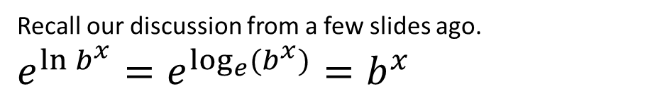
Required to Prove: $\frac{d\left(b^{x}\right)}{dx}=b^{x}\left(\ln{b}\right)$
Proof (continued):
$y^{′}=e^{x\ln{b}}(\ln{b)}$
$y^{′}=e^{\ln{b^{x}}}(\ln{b)}$
Recall our discussion from a few slides ago.
$e^{\ln{b^{x}}}=e^{\log_{e}{(b^{x})}}=b^{x}$

Slide 53


Required to Prove: $\frac{d\left(b^{x}\right)}{dx}=b^{x}\left(\ln{b}\right)$
Proof (continued):
$y^{′}=e^{x\ln{b}}(\ln{b)}$
$y^{′}=e^{\ln{b^{x}}}(\ln{b)}$
$y^{′}=b^{x}(\ln{b)}$
Therefore, $\frac{d\left(b^{x}\right)}{dx}=b^{x}(\ln{b)}$

Slide 54



We know the following
The derivative of ln x with respect to x is 1/x
The derivative of $e^{x}$ with respect to x is $e^{x}$
The derivative of $b^{x}$ with respect to x is ($b^{x}$)(ln b)
Putting the last rule together with the chain rule, we get that the derivative of $b^{f(x)}$ is
$b^{f\left(x\right)}(\ln{b) f′(x)}$

Slide 55
How to differentiate an exponential function
To differentiate an exponential function, we can determine its derivative by doing the following:
Restate the function and multiply by the natural logarithm (in other words, ln) of the base and then also by the derivative of the exponent
This is assuming that x is in the exponent but not in the base; there's a different rule if x is in both the exponent and the base.

Slide 56

Example
Determine the derivative of $g\left(x\right)=e^{x^{2}−x}$

Slide 57

Determine the derivative of $g\left(x\right)=e^{x^{2}−x}$
Solution: g'(x) = $e^{x^{2}−x}(\ln{e)(2x−1)}$
= $e^{x^{2}−x}(1)(2x−1)$
= $\left(2x−1\right)e^{x^{2}−x}$

Slide 58

Example
Determine the derivative of the curve $f\left(x\right)=x^{2}e^{x}$

Slide 59

Determine the derivative of the curve $f\left(x\right)=x^{2}e^{x}$
Solution: Use the product rule
$f^{′}\left(x\right)=2xe^{x}+x^{2}e^{x}$
$=e^{x}(x^{2}+2x)$

Slide 60

Example:
Determine the equation of the tangent line to $y=\frac{e^{x}}{x^{2}}$ where x=1

Slide 61

Determine the equation of the tangent line to $y=\frac{e^{x}}{x^{2}}$ where x=1
Solution: We need the slope of the line and a point on the line.
quotient rule
$y^{′}=\frac{x^{2}e^{x}−e^{x}(2x)}{x^{4}}$
At x = 1, y'= $\frac{{(1)}^{2}e^{1}−e^{1}(2×1)}{{(1)}^{4}}=\frac{e−2e}{1}=−e$

Slide 62

Now we need a point on the line.
At x = 1, y $=\frac{e^{1}}{1^{2}}$
= $\frac{e}{1}$ = e
y = mx+b
= -ex+b
Substitute in x = 1 and y = e
e = -e(1) + b
This implies that b = 2e.
Therefore, the equation of the line is y = -ex + 2e

Slide 63

Example
Differentiate the function $f\left(x\right)=5^{x}$

Slide 64

Differentiate the function $f\left(x\right)=5^{x}$
Solution: f'(x) = $5^{x}(\ln{5)(1)}$
= $5^{x}(\ln{5)}$

Slide 65

Example
Differentiate the function $g\left(x\right)=5^{3x−2}$

Slide 66

Differentiate the function $g\left(x\right)=5^{3x−2}$
Solution: g'(x) = $5^{3x−2}(\ln{5)(3)}$
= $5^{3x−2}(3\ln{5})$

Slide 67

Example
Differentiate the function h(x) =$(8)7^{9x^{2}−5x+1}$

Slide 68

Differentiate the function h(x) =$(8)7^{9x^{2}−5x+1}$
Solution: h'(x) = $(8)7^{{9x}^{2}−5x+1}(\ln{7)(18x−5)}$

Slide 69

Word Problem
On January 1, 1850, the population of Goldrushtown was 50000. Since then the population of Goldrushtown can be expressed as
P(t)=50000 $(0.98)^{t}$.
a) What was the population of Goldrushtown on January 1, 1900?

Slide 70

On January 1, 1850, the population of Goldrushtown was 50000. Since then the population of Goldrushtown can be expressed as
P(t)=50000 $(0.98)^{t}$.
a) What was the population of Goldrushtown on January 1, 1900?
Solution: On January 1, 1900, t = 50
P(50) = 50000 $(0.98)^{50}$
≈ 50000 (0.3641697)
≈ 18 208

Slide 71
b) At what rate was the population changing on January 1, 1900?

Slide 72

b) At what rate was the population changing on January 1, 1900?
Solution: rate means derivative
P'(t)=50000 ${(0.98)}^{t}$ (ln 0.98) (1)
=50000 ${(0.98)}^{t}$ (ln 0.98)
P'(50) = 50000${(0.98)}^{50}$ (ln 0.98)
≈ - 368
Therefore the population was decreasing at a rate of approximately 368 people per year on January 1, 1900.

Slide 73

Word Problem Example
A radioactive substance decays exponentially. The percent, P, of the material left after after t years is P(t) = 100 $(1.015)^{−t}$.
a) What is the half-life?

Slide 74

Word Problem Example
A radioactive substance decays exponentially. The percent, P, of the material left after after t years is P(t) = 100 $(1.015)^{−t}$.
a) What is the half-life?
Solution: Let the percent remaining be 50 and solve for t
50 = 100 ${(1.015)}^{−t}$
0.5 = ${1.015}^{−t}$
-t = $\log_{1.015}0.5$
-t ≈ -46.6
t ≈ 46.6 Therefore the half-life is approximately 46.6 years

Slide 75
b) How fast is the substance decaying at that time?

Slide 76

b) How fast is the substance decaying at that time?
Solution: P'(46.6)=100${(1.015)}^{−46.6}$ (ln 1.015) (-1)
≈-0.74
Therefore at the time that the half-life is reach, the substance is decaying at a rate of approximately 0.74 percent of the original amount of the substance per year.

